Slide 1
Introduction to Sequence Analysis
Common File formats

Slide 2
Who am I?
The man talking right now?

Slide 3

About Me
My Name:
Steve Osazuwa
Company:
Via Scientific
Role:
Bioinformatician
Favourite Movie:
Dodgeball

Slide 4
Agenda
Sequencing Introduction
Illumina Sequencing overview
File Formats
Sequence File Formats
Alignment Formats
Visualization Formats
Annotation Formats
Summary

Slide 5
Sequencing Introduction
Primary Analysis → Secondary Analysis → Tertiary Analysis

Slide 6
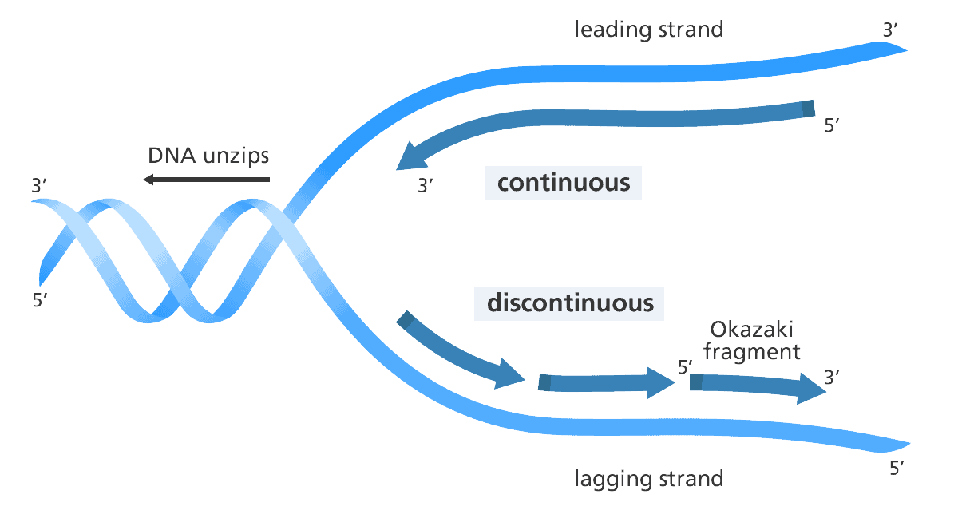
Terminology
Next-Generation Sequencing (NGS):
The umbrella term for modern high-throughput sequencing technologies
Short Read Sequencing:
NGS that involves breaking a genome into small fragments, 50-300 bases, before sequencing.
5’ (5 prime)
Start of a DNA or RNA strand where sequencing often begins.
3’ (3 prime)
End of a DNA or RNA strand where sequencing often begin

Slide 7
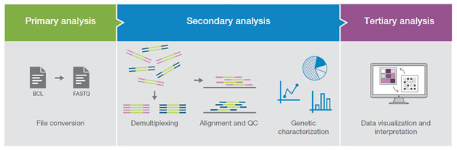
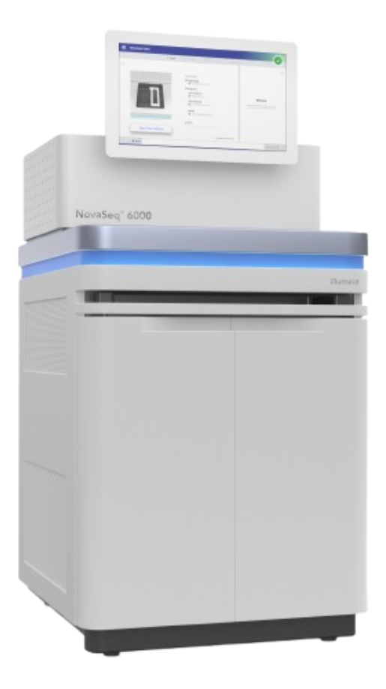

Analysis: Primary →Secondary → Tertiary
Wet-lab + Sequencing → Analysis Ready data → Downstream Processing

Slide 8
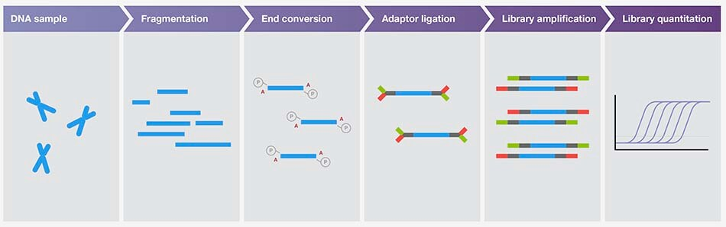
Analysis: Primary (short read)
Notes:
This is HIGH level. In Lab SOPs there are many variations and customization, done for experimental needs.

Slide 9
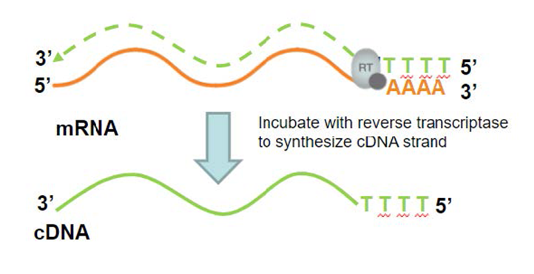
Analysis: Primary (short read)
Same process possible with RNA Conversion of RNA → cDNA required

Slide 10
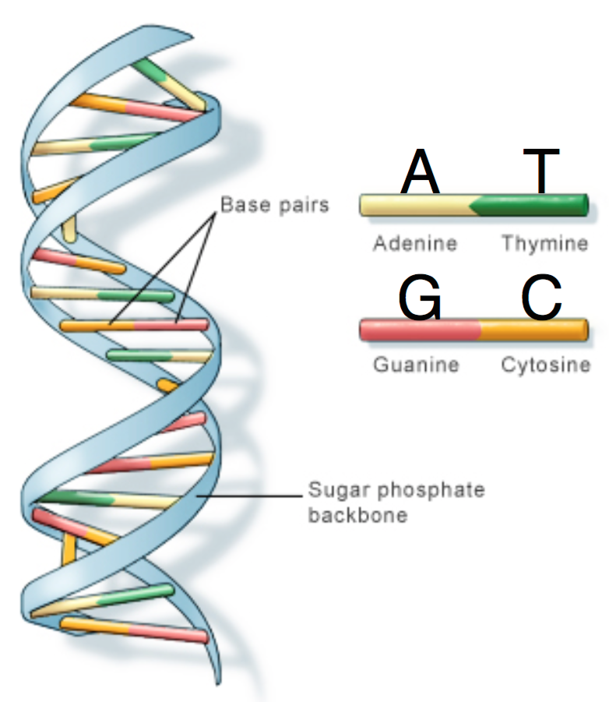
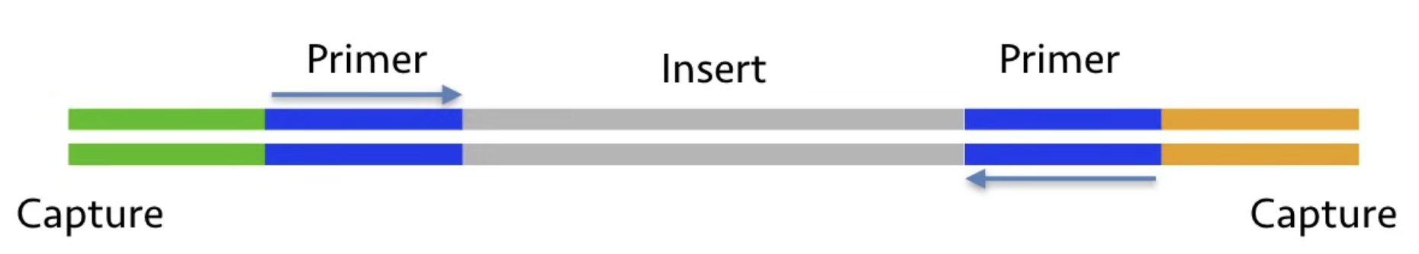
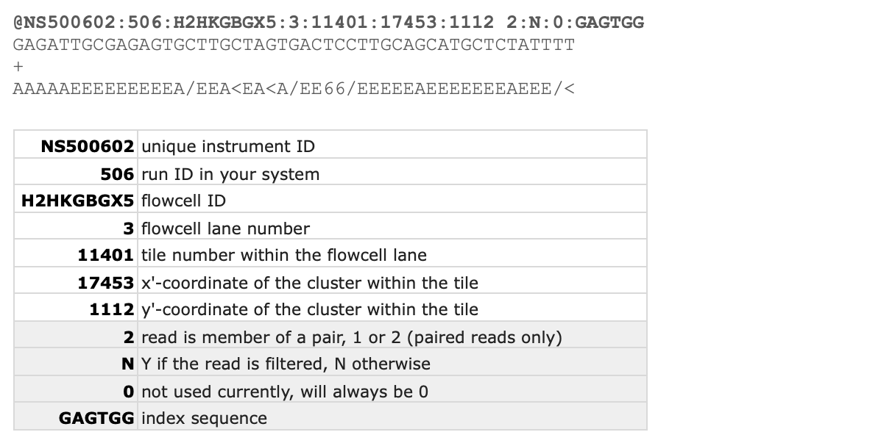
Sequencing Introduction
Primary Analysis
Secondary Analysis
…
A
G
C
T
A
G
C
T
…
Insert
Fragment
Notes:
Mention “Green” = Platform specific seq NOT sample of interest

Slide 11
Sequencing Introduction
Primary Analysis
Secondary Analysis
…
A
G
C
T
A
G
C
T
…
Insert
Fragment
Platform specific sequences
Notes:
Mention “Green” = Platform specific seq NOT sample of interest

Slide 12
Aside: Sequencing the insert
…
A
G
C
T
A
G
C
T
Platform Specific sequence
Insert
Short read Seq How do we sequence the insert?
Notes:
Maybe ask question:
Hint there are 2 approaches

Slide 13
Aside: Single versus Paired end sequencing
Sequencing
Single
…
Insert
Sequencing
Paired
…
Insert
…

Slide 14
Aside: Single versus Paired end sequencing
Sequencing
Single
…
Insert
Insert sequenced
Sequencing
Insert sequenced
Paired
…
Insert
…
Insert sequenced

Slide 15
Aside: Single-end Alignment
Sequencing
Single
…
Insert
Insert sequenced
Alignment
Insert sequenced
Reference

Slide 16
Aside: Paired-end Alignment (no overlap)
Sequencing
Insert sequenced
Paired
…
Insert
…
Insert sequenced
Alignment
Reference
Insert sequenced
Structural info.
Insert sequenced

Slide 17
Aside: Paired-end Alignment (w/ overlap)
Sequencing
Insert sequenced
Paired
…
Insert
…
Insert sequenced
Alignment
Insert sequenced
Reference
Insert sequenced
Structural info. High confidence alignments

Slide 18
Aside: Single v Paired end sequencing
Application | Single or Paired End Seq? | Considerations?
SNP Detection | Either | Higher Coverage - better
INDEL detection | Paired-End | Need structural information
Structural Variation Detection | Paired-End | Need structural information
Genome Assembly | Paired-End | Need structural information
RNA Seq | Either | Depends heavily on use-case
Notes:
For RNA-seq
If you’re working with small RNA SE is fine
Capture insert well with Seq

Slide 19
Illumina Sequencing overview
Sequencing By Synthesis

Slide 20
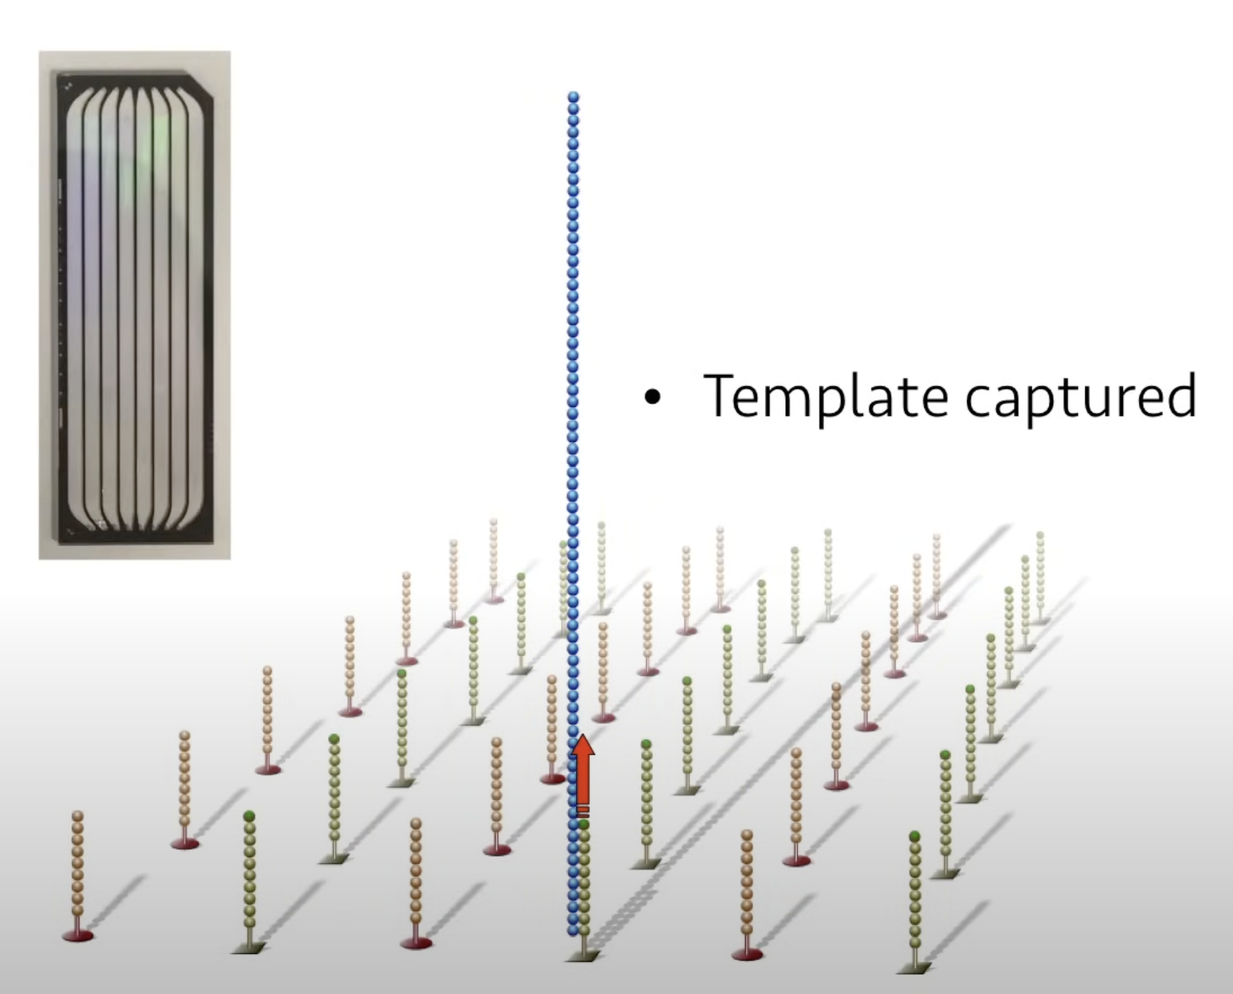
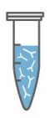
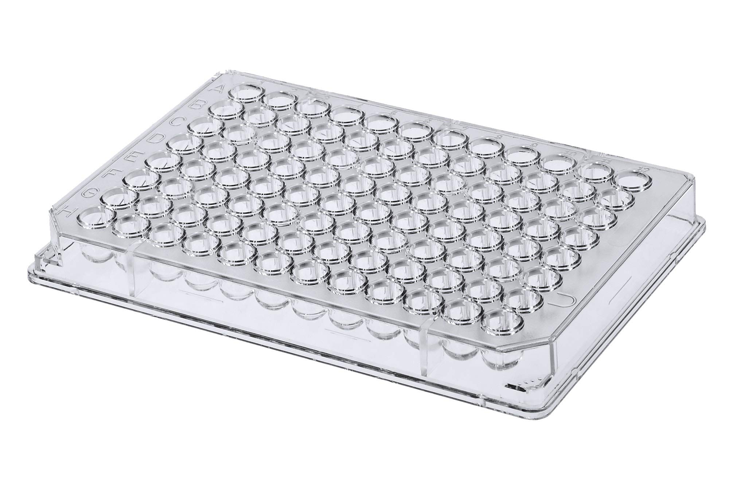
Multiplexing Libraries
Index
Unique samples Each well
Combined “Multiplexed” Sample
Load Multiplex to flow cell
Good Novaseq overview: https://www.youtube.com/watch?v=s5p0JpR6QfY
Notes:
Save cost
Load Sequencer with enough library to properly function
Add Index to identify reads from your sample

Slide 21
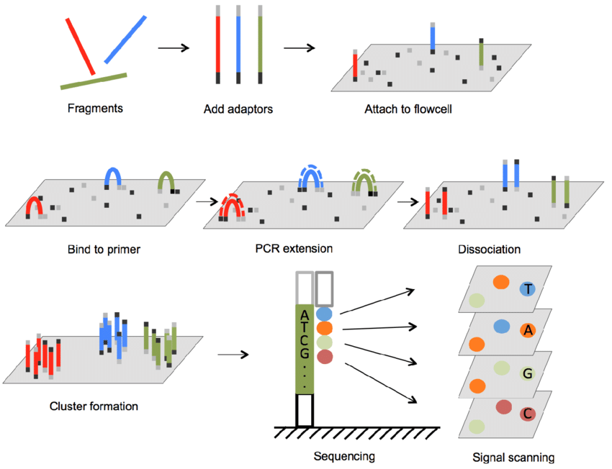
Illumina Sequencing By Synthesis

Slide 22

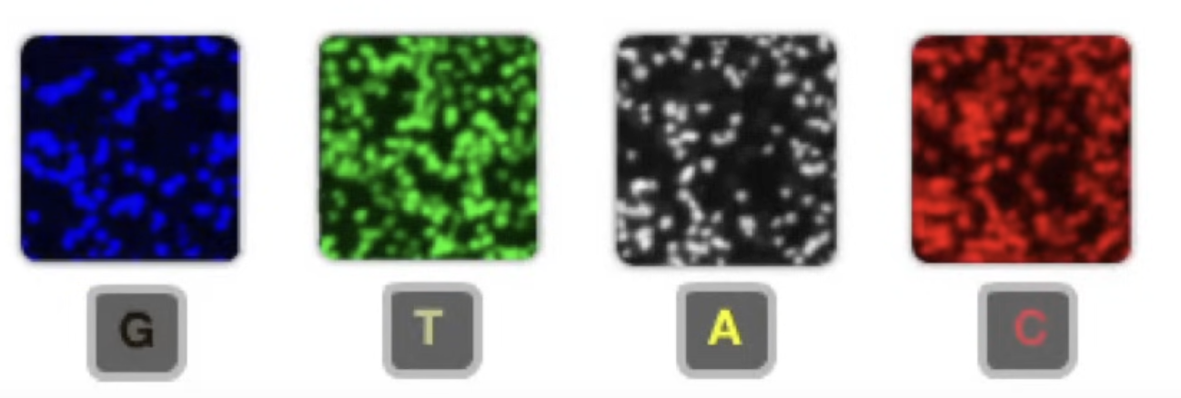
Illumina Sequencing By Synthesis
Read
Read

Slide 23
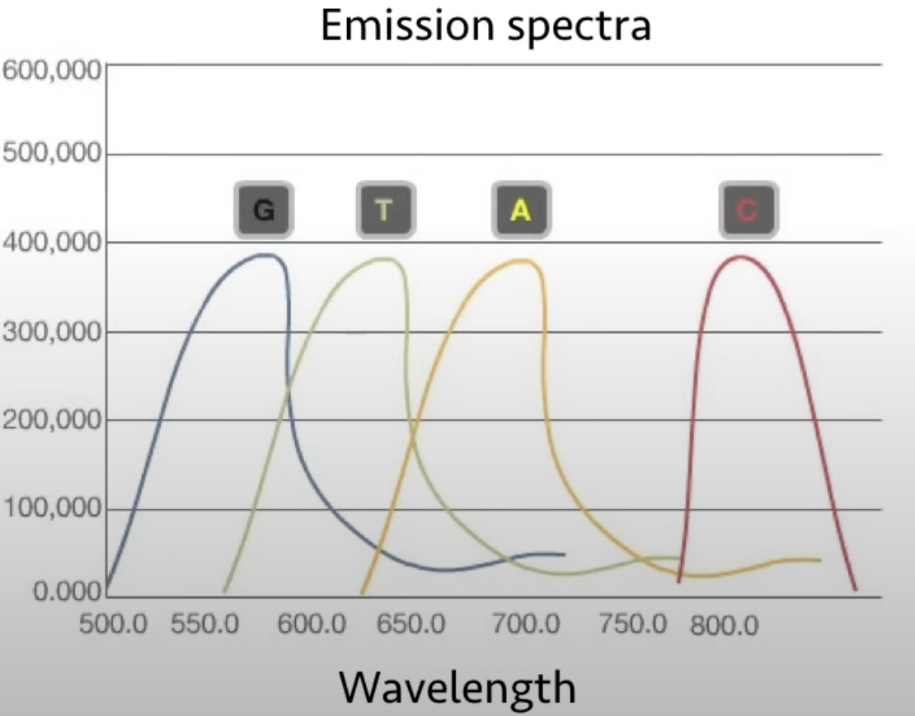
Illumina Sequencing By Synthesis

Slide 24
Sequencing Introduction
Primary Analysis
Secondary Analysis
Notes:
Mention “Green” = Platform specific seq NOT sample of interest

Slide 25
Sequence File Formats

Slide 26
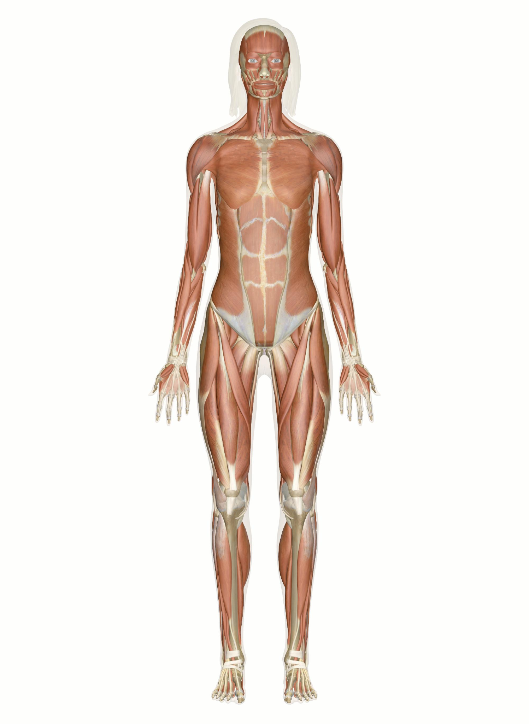

Sequence File Formats - FASTA
>chr22
NNNGCCGTCAGCCTTTTCTTTGACCTCTTCTTTCTGTTCATGTGTATTTGCTGTC…
Organism

Slide 27
Sequence File Formats - FASTA
Example FASTA
>ENST00000456328.2|ENSG00000223972.5|DDX11L1-202|DDX11L1|processed_transcript|
GTTAACTTGCCGTCAGCCTTTTCTTTGACCTCTTCTTTCTGTTCATGTGTATTTGCTGTC
>ENST00000461467.1|ENSG00000237613.2|OTTHUMT00000002843.1|lncRNA|
GGGGTTTCGGGGCTGTGGACCCTGTGCCAGGAAAGGAAGGGCGCAGCTCCTGCAATGCGG
…

Slide 28
Sequence File Formats - FASTA
Example FASTA
>ENST00000456328.2|ENSG00000223972.5|processed_transcript| whole_transcriptome_seq
NNNNNTGCCGTCAGCCTTTTCTTTGACCTCTTCTTTCTGTTCATGTGTATTTGCTGTC
Notes:
Header Line: Each sequence starts with a header line, beginning with a ">" symbol. This line includes
Identifier: A unique identifier for the sequence, often including database-specific codes (e.g., gi|1817694395|ref|NZ_JAAGMU010000151.1).
Description: Additional information about the sequence, such as the organism or the type of sequence (e.g., Streptomyces sp. SID7958 contig-52000002, whole genome shotgun sequence).
Sequence line: nucleotide or protein sequence, represented in single-letter codes
N’s are gaps in assemblies
Regions that are difficult to sequence or assemble
Highly repetitive sections of the genome
Areas where the exact sequence is yet to be determined

Slide 29
Sequence File Formats - FASTA entry
Example FASTA
Header
>ENST00000456328.2|ENSG00000223972.5|processed_transcript| whole_transcriptome_seq
NNNNNTGCCGTCAGCCTTTTCTTTGACCTCTTCTTTCTGTTCATGTGTATTTGCTGTC
Header Line: Each sequence starts with a header line, beginning with a ">" symbol.
Notes:
Header Line: Each sequence starts with a header line, beginning with a ">" symbol. This line includes
Identifier: A unique identifier for the sequence, often including database-specific codes (e.g., gi|1817694395|ref|NZ_JAAGMU010000151.1).
Description: Additional information about the sequence, such as the organism or the type of sequence (e.g., Streptomyces sp. SID7958 contig-52000002, whole genome shotgun sequence).
Sequence line: nucleotide or protein sequence, represented in single-letter codes
N’s are gaps in assemblies
Regions that are difficult to sequence or assemble
Highly repetitive sections of the genome
Areas where the exact sequence is yet to be determined

Slide 30
Sequence File Formats - FASTA entry
Example FASTA
Header
>ENST00000456328.2|ENSG00000223972.5|processed_transcript| whole_transcriptome_seq
Identifier
NNNNNTGCCGTCAGCCTTTTCTTTGACCTCTTCTTTCTGTTCATGTGTATTTGCTGTC
Header Line: Each sequence starts with a header line, beginning with a ">" symbol.
Identifier: A unique identifier for the sequence, often including database-specific codes
Notes:
Header Line: Each sequence starts with a header line, beginning with a ">" symbol. This line includes
Identifier: A unique identifier for the sequence, often including database-specific codes (e.g., gi|1817694395|ref|NZ_JAAGMU010000151.1).
Description: Additional information about the sequence, such as the organism or the type of sequence (e.g., Streptomyces sp. SID7958 contig-52000002, whole genome shotgun sequence).
Sequence line: nucleotide or protein sequence, represented in single-letter codes
N’s are gaps in assemblies
Regions that are difficult to sequence or assemble
Highly repetitive sections of the genome
Areas where the exact sequence is yet to be determined

Slide 31
Sequence File Formats - FASTA entry
Example FASTA
Header
>ENST00000456328.2|ENSG00000223972.5|processed_transcript| whole_transcriptome_seq
Identifier
Description
NNNNNTGCCGTCAGCCTTTTCTTTGACCTCTTCTTTCTGTTCATGTGTATTTGCTGTC
Header Line: Each sequence starts with a header line, beginning with a ">" symbol.
Identifier: A unique identifier for the sequence, often including database-specific codes
Description: Additional information about the sequence e.g. organism, type of sequence
Notes:
Header Line: Each sequence starts with a header line, beginning with a ">" symbol. This line includes
Identifier: A unique identifier for the sequence, often including database-specific codes (e.g., gi|1817694395|ref|NZ_JAAGMU010000151.1).
Description: Additional information about the sequence, such as the organism or the type of sequence (e.g., Streptomyces sp. SID7958 contig-52000002, whole genome shotgun sequence).
Sequence line: nucleotide or protein sequence, represented in single-letter codes
N’s are gaps in assemblies
Regions that are difficult to sequence or assemble
Highly repetitive sections of the genome
Areas where the exact sequence is yet to be determined

Slide 32
Sequence File Formats - FASTA entry
Example FASTA
Header
>ENST00000456328.2|ENSG00000223972.5|processed_transcript| whole_transcriptome_seq
Identifier
Description
Sequence
NNNNNTGCCGTCAGCCTTTTCTTTGACCTCTTCTTTCTGTTCATGTGTATTTGCTGTC
Header Line: Each sequence starts with a header line, beginning with a ">" symbol.
Identifier: A unique identifier for the sequence, often including database-specific codes
Description: Additional information about the sequence e.g. organism, type of sequence
Sequence: Nucleotide or protein sequence, represented in single-letter codes.
Notes:
Header Line: Each sequence starts with a header line, beginning with a ">" symbol. This line includes
Identifier: A unique identifier for the sequence, often including database-specific codes (e.g., gi|1817694395|ref|NZ_JAAGMU010000151.1).
Description: Additional information about the sequence, such as the organism or the type of sequence (e.g., Streptomyces sp. SID7958 contig-52000002, whole genome shotgun sequence).
Sequence line: nucleotide or protein sequence, represented in single-letter codes
N’s are gaps in assemblies
Regions that are difficult to sequence or assemble
Highly repetitive sections of the genome
Areas where the exact sequence is yet to be determined

Slide 33
Sequence File Formats - FASTA summary
Example FASTA
>ENST00000456328.2|ENSG00000223972.5|DDX11L1-202|DDX11L1|processed_transcript|
GTTAACTTGCCGTCAGCCTTTTCTTTGACCTCTTCTTTCTGTTCATGTGTATTTGCTGTC
>ENST00000461467.1|ENSG00000237613.2|OTTHUMT00000002843.1|lncRNA|
GGGGTTTCGGGGCTGTGGACCCTGTGCCAGGAAAGGAAGGGCGCAGCTCCTGCAATGCGG
…
Extension | *.fasta, *.fa,
File type | Text
Applications | Sequence Alignment (BLAST), Assembly (QIIME), Database (NCBI),
Notes:
Example FASTA from Gencode GRCh38.p13 Transcripts
Header Line: Each sequence starts with a header line, beginning with a ">" symbol. This line includes
Identifier: A unique identifier for the sequence, often including database-specific codes (e.g., gi|1817694395|ref|NZ_JAAGMU010000151.1).
Description: Additional information about the sequence, such as the organism or the type of sequence (e.g., Streptomyces sp. SID7958 contig-52000002, whole genome shotgun sequence).

Slide 34
Sequence File Formats - FASTQ Read
FASTQ file
@NS500602:506:H2HKGBGX5:3:11401:17453:1112 2:N:0:GAGTGG
GAGATTGCGAGAGTGCTTGCTAGTGACTCCTTGCAGCATGCTCTATTTT
+
AAAAAEEEEEEEEEA/EEA<EA<A/EE66/EEEEEAEEEEEEEAEEE/<
.
.
.

Slide 35
Sequence File Formats - “Reads”
Sequenced
Platform Specific sequence
A
G
C
T
A
G
C
T
Platform Specific sequence
Sequenced

Slide 36
Sequence File Formats - “Reads”
Sequenced
Platform Specific sequence
A
G
C
T
A
G
C
T
Platform Specific sequence
Sequenced
These are “Reads”

Slide 37
Sequence File Formats - “Reads”
Sequenced
A
G
C
T
Platform Specific sequence

Slide 38
Sequence File Formats - “Reads”
Sequenced
Insert
Platform Specific sequence
Reads are often “preprocessed” to isolate the “Insert”

Slide 39
Sequence File Formats - “Reads”
Sequenced
Insert
Reads are often “preprocessed” to isolate the “Insert”
Tools like “Cutadapt” are used to remove platform specific sequences

Slide 40
Sequence File Formats - “Reads”
This is a “Read”
Sequenced
Insert
Reads are often “preprocessed” to isolate the “Insert”
Tools like “Cutadapt” are used to remove platform specific sequences

Slide 41
Sequence File Formats - FASTQ Read
FASTQ file
@NS500602:506:H2HKGBGX5:3:11401:17453:1112 2:N:0:GAGTGG
GAGATTGCGAGAGTGCTTGCTAGTGACTCCTTGCAGCATGCTCTATTTT
+
AAAAAEEEEEEEEEA/EEA<EA<A/EE66/EEEEEAEEEEEEEAEEE/<
.
.
.
Read

Slide 42
Sequence File Formats - FASTQ Read
FASTQ file
@NS500602:506:H2HKGBGX5:3:11401:17453:1112 2:N:0:GAGTGG
GAGATTGCGAGAGTGCTTGCTAGTGACTCCTTGCAGCATGCTCTATTTT
+
AAAAAEEEEEEEEEA/EEA<EA<A/EE66/EEEEEAEEEEEEEAEEE/<

Slide 43
Sequence File Formats - FASTQ Read
FASTQ file
Read Name (Sequence Identifier)
@NS500602:506:H2HKGBGX5:3:11401:17453:1112 2:N:0:GAGTGG
GAGATTGCGAGAGTGCTTGCTAGTGACTCCTTGCAGCATGCTCTATTTT
+
AAAAAEEEEEEEEEA/EEA<EA<A/EE66/EEEEEAEEEEEEEAEEE/<
Read Name: line starts with '@' and provides information about the sequence.

Slide 44
Aside: Anatomy of a Read Name

Slide 45
Sequence File Formats - FASTQ Read
FASTQ file
Read Name (Sequence Identifier)
@NS500602:506:H2HKGBGX5:3:11401:17453:1112 2:N:0:GAGTGG
GAGATTGCGAGAGTGCTTGCTAGTGACTCCTTGCAGCATGCTCTATTTT
+
AAAAAEEEEEEEEEA/EEA<EA<A/EE66/EEEEEAEEEEEEEAEEE/<
Read Name: line starts with '@' and provides information about the sequence.

Slide 46
Sequence File Formats - FASTQ Read
FASTQ file
Read Name (Sequence Identifier)
@NS500602:506:H2HKGBGX5:3:11401:17453:1112 2:N:0:GAGTGG
GAGATTGCGAGAGTGCTTGCTAGTGACTCCTTGCAGCATGCTCTATTTT
+
AAAAAEEEEEEEEEA/EEA<EA<A/EE66/EEEEEAEEEEEEEAEEE/<
Raw Sequence
Read Name: line starts with '@' and provides information about the sequence.
Raw Sequence: Sequence captured by sequencing instrument

Slide 47
Sequence File Formats - FASTQ Read
FASTQ file
Read Name (Sequence Identifier)
@NS500602:506:H2HKGBGX5:3:11401:17453:1112 2:N:0:GAGTGG
GAGATTGCGAGAGTGCTTGCTAGTGACTCCTTGCAGCATGCTCTATTTT
+
AAAAAEEEEEEEEEA/EEA<EA<A/EE66/EEEEEAEEEEEEEAEEE/<
Raw Sequence
Separator Line
Read Name: line starts with '@' and provides information about the sequence.
Raw Sequence: Sequence captured by sequencing instrument
Separator Line: Rarely used. Starts with '+', often blank or repeats the sequence identifier.

Slide 48
Sequence File Formats - FASTQ Read
FASTQ file
Read Name (Sequence Identifier)
@NS500602:506:H2HKGBGX5:3:11401:17453:1112 2:N:0:GAGTGG
GAGATTGCGAGAGTGCTTGCTAGTGACTCCTTGCAGCATGCTCTATTTT
+
AAAAAEEEEEEEEEA/EEA<EA<A/EE66/EEEEEAEEEEEEEAEEE/<
Raw Sequence
Separator Line
Quality Scores
Read Name: line starts with '@' and provides information about the sequence.
Raw Sequence: Sequence captured by sequencing instrument
Separator Line: Rarely used. Starts with '+', often blank or repeats the sequence identifier.
Quality Scores: Sequencer confidence in base call

Slide 49
Aside: Quality Scores
@NS500602:506:H2HKGBGX5:3:11401:17453:1112 2:N:0:GAGTGG
GAGATTGCGAGAGTGCTTGCTAGTGACTCCTTGCAGCATGCTCTATTTT
+
AAAAAEEEEEEEEEA/EEA<EA<A/EE66/EEEEEAEEEEEEEAEEE/<
Quality Scores
“A”? “E”? “6”?

Slide 50

Aside: Quality Scores
@NS500602:506:H2HKGBGX5:3:11401:17453:1112 2:N:0:GAGTGG
GAGATTGCGAGAGTGCTTGCTAGTGACTCCTTGCAGCATGCTCTATTTT
+
AAAAAEEEEEEEEEA/EEA<EA<A/EE66/EEEEEAEEEEEEEAEEE/<
Quality Scores
“A”? “E”? “6”?
Incorrect base call

Slide 51
Aside: Quality Scores
@NS500602:506:H2HKGBGX5:3:11401:17453:1112 2:N:0:GAGTGG
GAGATTGCGAGAGTGCTTGCTAGTGACTCCTTGCAGCATGCTCTATTTT
+
AAAAAEEEEEEEEEA/EEA<EA<A/EE66/EEEEEAEEEEEEEAEEE/<
Quality Scores
“A”? “E”? “6”?
“A”? “E”? “6”?
Incorrect base call
ASCII
Phred Score

Slide 52
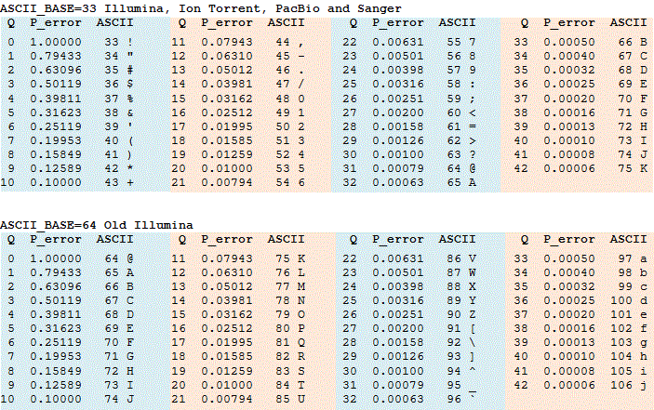
Aside: Quality Scores
@NS500602:506:H2HKGBGX5:3:11401:17453:1112 2:N:0:GAGTGG
GAGATTGCGAGAGTGCTTGCTAGTGACTCCTTGCAGCATGCTCTATTTT
+
AAAAAEEEEEEEEEA/EEA<EA<A/EE66/EEEEEAEEEEEEEAEEE/<
Quality Scores
“A”? “E”? “6”?
“A”? “E”? “6”?
Incorrect base call
ASCII
Phred Score

Slide 53
Aside: Quality Scores

Slide 54
Aside: Quality Scores

Slide 55
Aside: Quality Scores
@NS500602:506:H2HKGBGX5:3:11401:17453:1112 2:N:0:GAGTGG
GAGATTGCGAGAGTGCTTGCTAGTGACTCCTTGCAGCATGCTCTATTTT
+
AAAAAEEEEEEEEEA/EEA<EA<A/EE66/EEEEEAEEEEEEEAEEE/<
10^( -32/10 )
32 (phred-33)
“A”
Phred Quality Score | Probability of incorrect base call | Base call accuracy
10 | 1 in 10 | 90%
20 | 1 in 100 | 99%
30 | 1 in 1000 | 99.9%
40 | 1 in 10,000 | 99.99%
50 | 1 in 100,000 | 99.999%
60 | 1 in 1,000,000 | 99.9999%

Slide 56
Sequence File Formats - FASTQ Read
FASTQ file
Read Name (Sequence Identifier)
@NS500602:506:H2HKGBGX5:3:11401:17453:1112 2:N:0:GAGTGG
GAGATTGCGAGAGTGCTTGCTAGTGACTCCTTGCAGCATGCTCTATTTT
+
AAAAAEEEEEEEEEA/EEA<EA<A/EE66/EEEEEAEEEEEEEAEEE/<
Raw Sequence
Separator Line
Quality Scores

Slide 57
Sequence File Formats - FASTQ Summary
FASTQ file
@NS500602:506:H2HKGBGX5:3:11401:17453:1112 2:N:0:GAGTGG
GAGATTGCGAGAGTGCTTGCTAGTGACTCCTTGCAGCATGCTCTATTTT
+
AAAAAEEEEEEEEEA/EEA<EA<A/EE66/EEEEEAEEEEEEEAEEE/<
…
Extension | *.fastq, *.fq,
File type | Text
Applications | Alignment, Quality Control, Variant Calling

Slide 58
Alignment Formats

Slide 59
Alignment Formats
Sequencing Alignment/Map format (SAM) Format
BAM files
BAI indexes
Reference
Read
Read
Read
Read
Read
Read
Read
Read
Read
Notes:
Talk about Read Alignment

Slide 60
Alignment Formats
Sequencing Alignment/Map format (SAM) Format
BAM files
BAI indexes
Reference
Read
Read
Read
Read
Read
Read
Read
Read
These Reads are Aligned to a Reference sequence
Read

Slide 61
Alignment Formats - SAM format
@HD VN:1.6 SO:coordinate @SQ SN:ref LN:45
… r001 99 ref 7 30 8M2I4M1D3M = 37 39 TTAGATAAAGGATACTG * r002 0 ref 9 30 3S6M1P1I4M * 0 0 AAAAGATAAGGATA * r003 0 ref 9 30 5S6M * 0 0 GCCTAAGCTAA * SA:Z:ref,29,-,6H5M,17,0; r004 0 ref 16 30 6M14N5M * 0 0 ATAGCTTCAGC * r003 2064 ref 29 17 6H5M * 0 0 TAGGC * SA:Z:ref,9,+,5S6M,30,1; r001 147 ref 37 30 9M = 7 -39 CAGCGGCAT * NM:i:1
…
Sequenced
Sequenced
…
Notes:
Slide content from SAM spec
TODO: Simplify and Make table so easier to see

Slide 62
Alignment Formats - SAM format
@HD VN:1.6 SO:coordinate @SQ SN:ref LN:45
… r001 99 ref 7 30 8M2I4M1D3M = 37 39 TTAGATAAAGGATACTG * r002 0 ref 9 30 3S6M1P1I4M * 0 0 AAAAGATAAGGATA * r003 0 ref 9 30 5S6M * 0 0 GCCTAAGCTAA * SA:Z:ref,29,-,6H5M,17,0; r004 0 ref 16 30 6M14N5M * 0 0 ATAGCTTCAGC * r003 2064 ref 29 17 6H5M * 0 0 TAGGC * SA:Z:ref,9,+,5S6M,30,1; r001 147 ref 37 30 9M = 7 -39 CAGCGGCAT * NM:i:1
…
Notes:
Slide content from SAM spec
TODO: Simplify and Make table so easier to see

Slide 63
Alignment Formats - SAM format
@HD VN:1.6 SO:coordinate @SQ SN:ref LN:45
… r001 99 ref 7 30 8M2I4M1D3M = 37 39 TTAGATAAAGGATACTG * r002 0 ref 9 30 3S6M1P1I4M * 0 0 AAAAGATAAGGATA * r003 0 ref 9 30 5S6M * 0 0 GCCTAAGCTAA * SA:Z:ref,29,-,6H5M,17,0; r004 0 ref 16 30 6M14N5M * 0 0 ATAGCTTCAGC * r003 2064 ref 29 17 6H5M * 0 0 TAGGC * SA:Z:ref,9,+,5S6M,30,1; r001 147 ref 37 30 9M = 7 -39 CAGCGGCAT * NM:i:1
…
Header
Notes:
Slide content from SAM spec
TODO: Simplify and Make table so easier to see

Slide 64
Alignment Formats - SAM format
@HD VN:1.6 SO:coordinate @SQ SN:ref LN:45
… r001 99 ref 7 30 8M2I4M1D3M = 37 39 TTAGATAAAGGATACTG * r002 0 ref 9 30 3S6M1P1I4M * 0 0 AAAAGATAAGGATA * r003 0 ref 9 30 5S6M * 0 0 GCCTAAGCTAA * SA:Z:ref,29,-,6H5M,17,0; r004 0 ref 16 30 6M14N5M * 0 0 ATAGCTTCAGC * r003 2064 ref 29 17 6H5M * 0 0 TAGGC * SA:Z:ref,9,+,5S6M,30,1; r001 147 ref 37 30 9M = 7 -39 CAGCGGCAT * NM:i:1
…
Header
File metadata
Alignment Sorting order
TAGS
Notes:
Emphasize just be familiar with the term tags and know where it refers too

Slide 65
Alignment Formats - SAM format
@HD VN:1.6 SO:coordinate @SQ SN:ref LN:45
… r001 99 ref 7 30 8M2I4M1D3M = 37 39 TTAGATAAAGGATACTG * r002 0 ref 9 30 3S6M1P1I4M * 0 0 AAAAGATAAGGATA * r003 0 ref 9 30 5S6M * 0 0 GCCTAAGCTAA * SA:Z:ref,29,-,6H5M,17,0; r004 0 ref 16 30 6M14N5M * 0 0 ATAGCTTCAGC * r003 2064 ref 29 17 6H5M * 0 0 TAGGC * SA:Z:ref,9,+,5S6M,30,1; r001 147 ref 37 30 9M = 7 -39 CAGCGGCAT * NM:i:1
…
Header
Reference Sequence
Dictionary
Sequence Name
Length of sequence
TAGS
Notes:
Emphasize just be familiar with the term tags and know where it refers too

Slide 66
Alignment Formats - SAM format
@HD VN:1.6 SO:coordinate @SQ SN:ref LN:45
… r001 99 ref 7 30 8M2I4M1D3M = 37 39 TTAGATAAAGGATACTG * r002 0 ref 9 30 3S6M1P1I4M * 0 0 AAAAGATAAGGATA * r003 0 ref 9 30 5S6M * 0 0 GCCTAAGCTAA * SA:Z:ref,29,-,6H5M,17,0; r004 0 ref 16 30 6M14N5M * 0 0 ATAGCTTCAGC * r003 2064 ref 29 17 6H5M * 0 0 TAGGC * SA:Z:ref,9,+,5S6M,30,1; r001 147 ref 37 30 9M = 7 -39 CAGCGGCAT * NM:i:1
…
Header
Notes:
Slide content from SAM spec
TODO: Simplify and Make table so easier to see

Slide 67
Alignment Formats - SAM format
@HD VN:1.6 SO:coordinate @SQ SN:ref LN:45
… r001 99 ref 7 30 8M2I4M1D3M = 37 39 TTAGATAAAGGATACTG * r002 0 ref 9 30 3S6M1P1I4M * 0 0 AAAAGATAAGGATA * r003 0 ref 9 30 5S6M * 0 0 GCCTAAGCTAA * SA:Z:ref,29,-,6H5M,17,0; r004 0 ref 16 30 6M14N5M * 0 0 ATAGCTTCAGC * r003 2064 ref 29 17 6H5M * 0 0 TAGGC * SA:Z:ref,9,+,5S6M,30,1; r001 147 ref 37 30 9M = 7 -39 CAGCGGCAT * NM:i:1
…
Header
Alignments
Notes:
Slide content from SAM spec
TODO: Simplify and Make table so easier to see

Slide 68
Alignment Formats - SAM format
r001 99 ref 7 30 8M2I4M1D3M = 37 39 TTAGATAAAGGATACTG * r002 0 ref 9 30 3S6M1P1I4M * 0 0 AAAAGATAAGGATA * r003 0 ref 9 30 5S6M * 0 0 GCCTAAGCTAA * SA:Z:ref,29,-,6H5M,17,0; r004 0 ref 16 30 6M14N5M * 0 0 ATAGCTTCAGC * r003 2064 ref 29 17 6H5M * 0 0 TAGGC * SA:Z:ref,9,+,5S6M,30,1; …
Alignments
Notes:
Slide content from SAM spec
TODO: Simplify and Make table so easier to see

Slide 69
Alignment Formats - SAM format
r001 99 ref 7 30 8M2I4M1D3M = 37 39 TTAGATAAAGGATACTG * …
QNAME | FLAG | RNAME | POS | MAPQ | CIGAR | RNEXT | PNEXT | TLEN | SEQ | QUAL
r001 | 99 | ref | 7 | 30 | 8M2I4M… | = | 37 | 39 | TTAG… | *
Notes:
Slide content from SAM spec
TODO: Simplify and Make table so easier to see

Slide 70
Alignment Formats - SAM format
r001 99 ref 7 30 8M2I4M1D3M = 37 39 TTAGATAAAGGATACTG *
Query template name
Name can vary based on the sequencer/aligner. Field to be unique for each Read (pair)
QNAME | FLAG | RNAME | POS | MAPQ | CIGAR | RNEXT | PNEXT | TLEN | SEQ | QUAL
r001 | 99 | ref | 7 | 30 | 8M2I4M… | = | 37 | 39 | TTAG… | *
Notes:
Slide content from SAM spec
TODO: Simplify and Make table so easier to see

Slide 71
Alignment Formats - SAM format
HWUSI-EAS100R:6:73:941:1973#0/1
This QNAME contains: - Instrument name (HWUSI-EAS100R) - Lane number (6) - Tile number (73) - X-coordinate (941) - Y-coordinate (1973)
Index sequence (#0)
Read number (/1)
r001 99 ref 7 30 8M2I4M1D3M = 37 39 TTAGATAAAGGATACTG *
Query template name
Name can vary based on the sequencer/aligner. Field to be unique for each Read (pair)
QNAME | FLAG | RNAME | POS | MAPQ | CIGAR | RNEXT | PNEXT | TLEN | SEQ | QUAL
r001 | 99 | ref | 7 | 30 | 8M2I4M… | = | 37 | 39 | TTAG… | *
Notes:
Slide content from SAM spec
TODO: Simplify and Make table so easier to see

Slide 72
Alignment Formats - SAM format
Encoded detailed information about the alignment
r001 99 ref 7 30 8M2I4M1D3M = 37 39 TTAGATAAAGGATACTG *
QNAME | FLAG | RNAME | POS | MAPQ | CIGAR | RNEXT | PNEXT | TLEN | SEQ | QUAL
r001 | 99 | ref | 7 | 30 | 8M2I4M… | = | 37 | 39 | TTAG… | *
Notes:
Sum of Bits that are set

Slide 73
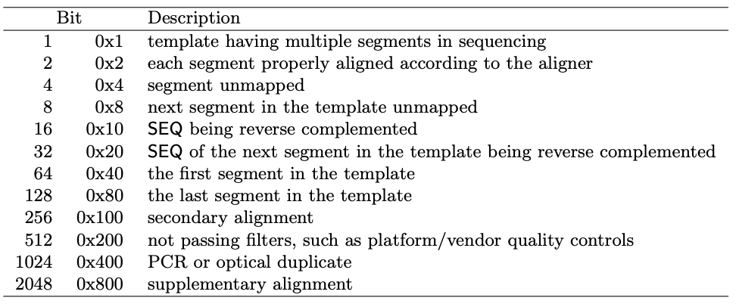
Alignment Formats - SAM format
Encoded detailed information about the alignment
r001 99 ref 7 30 8M2I4M1D3M = 37 39 TTAGATAAAGGATACTG *
Refer to manual often Try BROADs Explain SAM Flags
QNAME | FLAG | RNAME | POS | MAPQ | CIGAR | RNEXT | PNEXT | TLEN | SEQ | QUAL
r001 | 99 | ref | 7 | 30 | 8M2I4M… | = | 37 | 39 | TTAG… | *
Notes:
Sum of Bits that are set

Slide 74
Alignment Formats - SAM format
Reference sequence name.
r001 99 ref 7 30 8M2I4M1D3M = 37 39 TTAGATAAAGGATACTG *
QNAME | FLAG | RNAME | POS | MAPQ | CIGAR | RNEXT | PNEXT | TLEN | SEQ | QUAL
r001 | 99 | ref | 7 | 30 | 8M2I4M… | = | 37 | 39 | TTAG… | *
Notes:
Sum of Bits that are set

Slide 75
Alignment Formats - SAM format
leftmost mapping position. 1 based
r001 99 ref 7 30 8M2I4M1D3M = 37 39 TTAGATAAAGGATACTG *
QNAME | FLAG | RNAME | POS | MAPQ | CIGAR | RNEXT | PNEXT | TLEN | SEQ | QUAL
r001 | 99 | ref | 7 | 30 | 8M2I4M… | = | 37 | 39 | TTAG… | *
Notes:
Sum of Bits that are set

Slide 76
Alignment Formats - SAM format
Mapping quality. Calculation similar to Phred scale
r001 99 ref 7 30 8M2I4M1D3M = 37 39 TTAGATAAAGGATACTG *
From the Specification s −10 log10 Pr{mapping position is wrong}, rounded to the nearest integer. A value 255 indicates that the mapping quality is not available.
QNAME | FLAG | RNAME | POS | MAPQ | CIGAR | RNEXT | PNEXT | TLEN | SEQ | QUAL
r001 | 99 | ref | 7 | 30 | 8M2I4M… | = | 37 | 39 | TTAG… | *
Notes:
Sum of Bits that are set

Slide 77
Alignment Formats - SAM format
Concisely describes how a read aligns to the reference sequence
r001 99 ref 7 30 8M2I4M1D3M = 37 39 TTAGATAAAGGATACTG *
QNAME | FLAG | RNAME | POS | MAPQ | CIGAR | RNEXT | PNEXT | TLEN | SEQ | QUAL
r001 | 99 | ref | 7 | 30 | 8M2I4M… | = | 37 | 39 | TTAG… | *
Notes:
Sum of Bits that are set

Slide 78
Alignment Formats - SAM format
Concisely describes how a read aligns to the reference sequence
r001 99 ref 7 30 8M2I4M1D3M = 37 39 TTAGATAAAGGATACTG *
Reference
…
Read
8M2I4M… =
8 Mapping
2 Inserted
4 Mapping
QNAME | FLAG | RNAME | POS | MAPQ | CIGAR | RNEXT | PNEXT | TLEN | SEQ | QUAL
r001 | 99 | ref | 7 | 30 | 8M2I4M… | = | 37 | 39 | TTAG… | *
Notes:
Sum of Bits that are set

Slide 79
Alignment Formats - SAM format
Concisely describes how a read aligns to the reference sequence
r001 99 ref 7 30 8M2I4M1D3M = 37 39 TTAGATAAAGGATACTG *
Series of letters (M, I, D, etc.) and numbers represent matches, insertions, deletions, and other alignment operations.
Reference
…
Read
8M2I4M… =
8 Mapping
2 Inserted
4 Mapping
QNAME | FLAG | RNAME | POS | MAPQ | CIGAR | RNEXT | PNEXT | TLEN | SEQ | QUAL
r001 | 99 | ref | 7 | 30 | 8M2I4M… | = | 37 | 39 | TTAG… | *
Notes:
Sum of Bits that are set

Slide 80
Alignment Formats - SAM format
Reference sequence/contig the Reads pair maps to “=” means reads map to the same sequence/contig
r001 99 ref 7 30 8M2I4M1D3M = 37 39 TTAGATAAAGGATACTG *
QNAME | FLAG | RNAME | POS | MAPQ | CIGAR | RNEXT | PNEXT | TLEN | SEQ | QUAL
r001 | 99 | ref | 7 | 30 | 8M2I4M… | = | 37 | 39 | TTAG… | *
Notes:
Sum of Bits that are set

Slide 81
Alignment Formats - SAM format
1-based leftmost position of the mate
r001 99 ref 7 30 8M2I4M1D3M = 37 39 TTAGATAAAGGATACTG *
QNAME | FLAG | RNAME | POS | MAPQ | CIGAR | RNEXT | PNEXT | TLEN | SEQ | QUAL
r001 | 99 | ref | 7 | 30 | 8M2I4M… | = | 37 | 39 | TTAG… | *
Notes:
Sum of Bits that are set

Slide 82
Alignment Formats - SAM format
Template Length
r001 99 ref 7 30 8M2I4M1D3M = 37 39 TTAGATAAAGGATACTG *
QNAME | FLAG | RNAME | POS | MAPQ | CIGAR | RNEXT | PNEXT | TLEN | SEQ | QUAL
r001 | 99 | ref | 7 | 30 | 8M2I4M… | = | 37 | 39 | TTAG… | *
Notes:
Sum of Bits that are set

Slide 83
Alignment Formats - SAM format
Template Length
r001 99 ref 7 30 8M2I4M1D3M = 37 39 TTAGATAAAGGATACTG *
…
A
G
C
T
A
G
C
T
…
Insert
“Template” is often just the “insert” sequenced.
This can change depending on preprocessing
Fragment
QNAME | FLAG | RNAME | POS | MAPQ | CIGAR | RNEXT | PNEXT | TLEN | SEQ | QUAL
r001 | 99 | ref | 7 | 30 | 8M2I4M… | = | 37 | 39 | TTAG… | *
Notes:
Sum of Bits that are set

Slide 84
Alignment Formats - SAM format
sequence of the read
r001 99 ref 7 30 8M2I4M1D3M = 37 39 TTAGATAAAGGATACTG *
QNAME | FLAG | RNAME | POS | MAPQ | CIGAR | RNEXT | PNEXT | TLEN | SEQ | QUAL
r001 | 99 | ref | 7 | 30 | 8M2I4M… | = | 37 | 39 | TTAG… | *
Notes:
Sum of Bits that are set

Slide 85
Alignment Formats - SAM format
Quality score for each base in the read
r001 99 ref 7 30 8M2I4M1D3M = 37 39 TTAGATAAAGGATACTG *
Same as the Quality score in the FASTQ
QNAME | FLAG | RNAME | POS | MAPQ | CIGAR | RNEXT | PNEXT | TLEN | SEQ | QUAL
r001 | 99 | ref | 7 | 30 | 8M2I4M… | = | 37 | 39 | TTAG… | *
Notes:
Sum of Bits that are set

Slide 86
Alignment Formats - SAM format
@HD VN:1.6 SO:coordinate @SQ SN:ref LN:45 …
r001 99 ref 7 30 8M2I4M1D3M = 37 39 TTAGATAAAGGATACTG * r002 0 ref 9 30 3S6M1P1I4M * 0 0 AAAAGATAAGGATA * r003 0 ref 9 30 5S6M * 0 0 GCCTAAGCTAA * SA:Z:ref,29,-,6H5M,17,0; r004 0 ref 16 30 6M14N5M * 0 0 ATAGCTTCAGC *i:1 …
Header
Alignments
Extension | *.sam
File type | Text, follows SAM Specification
Applications | Downstream Analysis (Tertiary Analysis)
Notes:
Slide content from SAM spec
TODO: Simplify and Make table so easier to see

Slide 87
Alignment Formats - SAM format
@HD VN:1.6 SO:coordinate @SQ SN:ref LN:45 …
r001 99 ref 7 30 8M2I4M1D3M = 37 39 TTAGATAAAGGATACTG * r002 0 ref 9 30 3S6M1P1I4M * 0 0 AAAAGATAAGGATA * r003 0 ref 9 30 5S6M * 0 0 GCCTAAGCTAA * SA:Z:ref,29,-,6H5M,17,0; r004 0 ref 16 30 6M14N5M * 0 0 ATAGCTTCAGC *i:1 …
Header
See SAM Specification for more information
https://samtools.github.io/hts-specs/SAMv1.pdf
Alignments
Extension | *.sam
File type | Text, follows SAM Specification
Applications | Downstream Analysis (Tertiary Analysis)
Notes:
Slide content from SAM spec
TODO: Simplify and Make table so easier to see

Slide 88
Alignment Formats - BAM format
Notes:
Slide content from SAM spec
TODO: Simplify and Make table so easier to see

Slide 89
Alignment Formats - BAM format
@HD VN:1.6 SO:coordinate @SQ SN:ref LN:45
… r001 99 ref 7 30 8M2I4M1D3M = 37 39 TTAGATAAAGGATACTG * r002 0 ref 9 30 3S6M1P1I4M * 0 0 AAAAGATAAGGATA * r003 0 ref 9 30 5S6M * 0 0 GCCTAAGCTAA * SA:Z:ref,29,-,6H5M,17,0; r004 0 ref 16 30 6M14N5M * 0 0 ATAGCTTCAGC * r003 2064 ref 29 17 6H5M * 0 0 TAGGC * SA:Z:ref,9,+,5S6M,30,1; r001 147 ref 37 30 9M = 7 -39 CAGCGGCAT * NM:i:1
…
Information contained in BAM
Notes:
Slide content from SAM spec
TODO: Simplify and Make table so easier to see

Slide 90
Alignment Formats - BAM format
@HD VN:1.6 SO:coordinate @SQ SN:ref LN:45
… r001 99 ref 7 30 8M2I4M1D3M = 37 39 TTAGATAAAGGATACTG * r002 0 ref 9 30 3S6M1P1I4M * 0 0 AAAAGATAAGGATA * r003 0 ref 9 30 5S6M * 0 0 GCCTAAGCTAA * SA:Z:ref,29,-,6H5M,17,0; r004 0 ref 16 30 6M14N5M * 0 0 ATAGCTTCAGC * r003 2064 ref 29 17 6H5M * 0 0 TAGGC * SA:Z:ref,9,+,5S6M,30,1; r001 147 ref 37 30 9M = 7 -39 CAGCGGCAT * NM:i:1
…
Same information as SAM
Just COMPRESSED in BINARY form*
Information contained in BAM
Notes:
Slide content from SAM spec
TODO: Simplify and Make table so easier to see

Slide 91

*Alignment Formats - BAM format and the BAI index
*.bam file
BAM files are Block compressed
BAI index allows Random access of the BAM
You don’t have to read most of the entire file to find Chromosome 20
BAI will tell how to find reads in BAM
header
READS
Block Zipped (BGZF)
header
READS
*.bam.bai
“samtools index {path to}.bam”
Notes:
Mention “An Index enables random access of a file. Enabling faster computation algorithms”

Slide 92
Visualization Formats

Slide 93


Visualization Formats
BigWig
TDF

Slide 94
Visualization Formats - BigWig
WIG
BigWig
wigToBigWig
OR
bedGraph
bedGraphToBigWig
Binary file

Slide 95
Visualization Formats - BigWig
WIG
BigWig
wigToBigWig
OR
bedGraph
bedGraphToBigWig
Binary file

Slide 96
Visualization Formats - BigWig
track type=bedGraph name="BedGraph Format" description="BedGraph format" visibility=full color=200,100,0 altColor=0,100,200 priority=20
chr1 1000 2000 0.25
chr1 2000 3000 0.50
chr1 3000 4000 0.75
chr2 1000 2000 1.00
chr2 2000 3000 0.85
BigWig
bedGraph
bedGraphToBigWig
Binary file

Slide 97
Visualization Formats - BigWig
track type=bedGraph name="BedGraph Format" description="BedGraph format" visibility=full color=200,100,0 altColor=0,100,200 priority=20
chr1 1000 2000 0.25
chr1 2000 3000 0.50
chr1 3000 4000 0.75
chr2 1000 2000 1.00
chr2 2000 3000 0.85
BigWig
bedGraph
bedGraphToBigWig
Binary file
Start
Stop
Value
chrom.sizes

Slide 98
Visualization Formats - BigWig
WIG
BigWig
OR
bedGraph
Extension | *.bw *.bigWig
File type | Structured Binary File
Applications | Visualization, Fast random access to specific genomic regions and values

Slide 99
Visualization Formats - TDF
WIG
OR
igvtools
TDF
bedGraph
OR
BAM

Slide 100
Visualization Formats - TDF
WIG
OR
igvtools
TDF
bedGraph
OR
BAM
Extension | *.tdf
File type | Structured Binary File
Applications | Visualization, Used primarily by IGV viewer

Slide 101
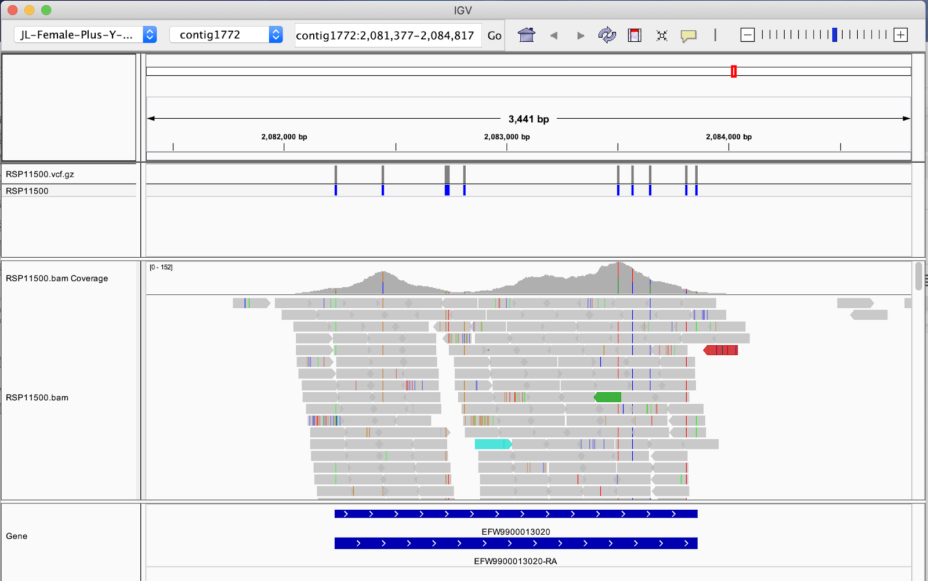
Visualization Formats - Tracks
Data Tracks
Alignment Tracks: Display aligned sequence reads (e.g., BAM files)
Copy Number Tracks: Show copy number variation data
Mutation Tracks: Highlight genetic mutations
Expression Tracks: Visualize gene expression levels
Methylation Tracks: Display DNA methylation data
Annotation Tracks
Gene Tracks: Show gene models and transcripts
Variant Tracks: Display genetic variants (e.g., VCF files)
Bed Tracks: Represent genomic intervals or regions
Other Track Types
Wiggle Tracks (continous data)
Sample Information Tracks (Sample Metadata)

Slide 102
Visualization Formats - Tracks
Data Tracks
Alignment Tracks: Display aligned sequence reads (e.g., BAM files)
Copy Number Tracks: Show copy number variation data
Mutation Tracks: Highlight genetic mutations
Expression Tracks: Visualize gene expression levels
Methylation Tracks: Display DNA methylation data
Annotation Tracks
Gene Tracks: Show gene models and transcripts
Variant Tracks: Display genetic variants (e.g., VCF files)
Bed Tracks: Represent genomic intervals or regions
Other Track Types
Wiggle Tracks (continous data)
Sample Information Tracks (Sample Metadata)
Annotation
Data
Annotation

Slide 103
Visualization Formats - Tracks
Data Tracks
Alignment Tracks: Display aligned sequence reads (e.g., BAM files)
Copy Number Tracks: Show copy number variation data
Mutation Tracks: Highlight genetic mutations
Expression Tracks: Visualize gene expression levels
Methylation Tracks: Display DNA methylation data
Annotation Tracks
Gene Tracks: Show gene models and transcripts
Variant Tracks: Display genetic variants (e.g., VCF files)
Bed Tracks: Represent genomic intervals or regions
Other Track Types
Wiggle Tracks (continous data)
Sample Information Tracks (Sample Metadata)
Get to know IGV (Desktop)
Annotation
Data
Annotation

Slide 104
Annotation Formats

Slide 105
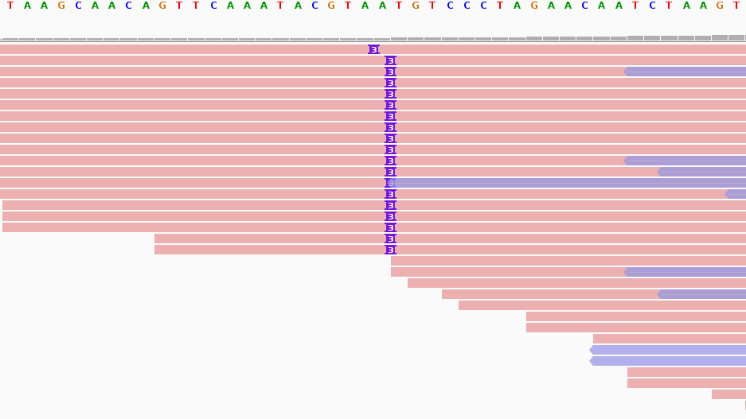
Annotation Formats
Variant Call Format (VCF)
Gene Transfer Format (GTF)
Browser Extensible Data (BED)

Slide 106
Annotation Formats - VCF
##fileformat=VCFv4.1 ##fileDate=20090805 ##source=myImputationProgramV3.1 ##reference=file:///seq/references/1000GenomesPilot-NCBI36.fasta ##contig=<ID=20,length=62435964,assembly=B36,md5=f126cdf8a6e0c7f379d618ff66beb2da,species="Homo sapiens",taxonomy=x> ##phasing=partial ##INFO=<ID=NS,Number=1,Type=Integer,Description="Number of Samples With Data"> ##INFO=<ID=DP,Number=1,Type=Integer,Description="Total Depth"> ##INFO=<ID=AF,Number=A,Type=Float,Description="Allele Frequency"> ##INFO=<ID=AA,Number=1,Type=String,Description="Ancestral Allele"> ##INFO=<ID=DB,Number=0,Type=Flag,Description="dbSNP membership, build 129"> ##INFO=<ID=H2,Number=0,Type=Flag,Description="HapMap2 membership"> ##FILTER=<ID=q10,Description="Quality below 10"> ##FILTER=<ID=s50,Description="Less than 50% of samples have data"> ##FORMAT=<ID=GT,Number=1,Type=String,Description="Genotype"> ##FORMAT=<ID=GQ,Number=1,Type=Integer,Description="Genotype Quality"> ##FORMAT=<ID=DP,Number=1,Type=Integer,Description="Read Depth"> ##FORMAT=<ID=HQ,Number=2,Type=Integer,Description="Haplotype Quality"> #CHROM POS ID REF ALT QUAL FILTER INFO FORMAT NA00001 NA00002 NA00003 20 14370 rs6054257 G A 29 PASS NS=3;DP=14;AF=0.5;DB;H2 GT:GQ:DP:HQ 0|0:48:1:51,51 1|0:48:8:51,51 1/1:43:5:.,. 20 17330 . T A 3 q10 NS=3;DP=11;AF=0.017 GT:GQ:DP:HQ 0|0:49:3:58,50 0|1:3:5:65,3 0/0:41:3 20 1110696 rs6040355 A G,T 67 PASS NS=2;DP=10;AF=0.333,0.667;AA=T;DB GT:GQ:DP:HQ 1|2:21:6:23,27 2|1:2:0:18,2 2/2:35:4 20 1230237 . T . 47 PASS NS=3;DP=13;AA=T GT:GQ:DP:HQ 0|0:54:7:56,60 0|0:48:4:51,51 0/0:61:2 20 1234567 microsat1 GTC G,GTCT 50 PASS NS=3;DP=9;AA=G GT:GQ:DP 0/1:35:4 0/2:17:2 1/1:40:3
Header
Data

Slide 107
Annotation Formats - VCF header
VCF version
##fileformat=VCFv4.1 ##fileDate=20090805 ##source=myImputationProgramV3.1 ##reference=file:///seq/references/1000GenomesPilot-NCBI36.fasta ##contig=<ID=20,length=62435964,assembly=B36,md5=f….> ##phasing=partial ##INFO=<ID=NS,Number=1,Type=Integer,Description="..."> ##INFO=<ID=DP,Number=1,Type=Integer,Description="Total Depth"> ##INFO=<ID=AF,Number=A,Type=Float,Description="Allele Frequency"> ##INFO=<ID=AA,Number=1,Type=String,Description="Ancestral Allele"> ##INFO=<ID=DB,Number=0,Type=Flag,Description="dbSNP membership, build 129"> ##INFO=<ID=H2,Number=0,Type=Flag,Description="HapMap2 membership"> ##FILTER=<ID=q10,Description="Quality below 10"> ##FILTER=<ID=s50,Description="Less than 50% of samples have data"> ##FORMAT=<ID=GT,Number=1,Type=String,Description="Genotype"> ##FORMAT=<ID=GQ,Number=1,Type=Integer,Description="Genotype Quality"> ##FORMAT=<ID=DP,Number=1,Type=Integer,Description="Read Depth"> ##FORMAT=<ID=HQ,Number=2,Type=Integer,Description="Haplotype Quality">
INFO columns description
FILTER col. descriptions
FORMAT col. descriptions

Slide 108
Annotation Formats - VCF
#CHROM POS ID REF ALT QUAL FILTER INFO FORMAT NA00001 NA00002 20 14370 rs6054257 G A 29 PASS NS=3;DP=14;AF=0.5;DB;H2 GT:GQ:DP:HQ 0|0:48:1:51,51 1|0:48:8:51,51
CHROM | POS | ID | REF | ALT | QUAL | FILTER | INFO | FORMAT | NA..1 | NA..2
20 | 14370 | rs6054257 | G | A | 29 | PASS | NS=3; DP=14; AF=0.5; DB;H2 | GT: GQ: DP: HQ | 0|0: 48: 1: 51,51 | 1|0: 48: 8: 51,51

Slide 109
Annotation Formats - VCF
#CHROM POS ID REF ALT QUAL FILTER INFO FORMAT NA00001 NA00002 20 14370 rs6054257 G A 29 PASS NS=3;DP=14;AF=0.5;DB;H2 GT:GQ:DP:HQ 0|0:48:1:51,51 1|0:48:8:51,51
Chromosome Identifier
CHROM | POS | ID | REF | ALT | QUAL | FILTER | INFO | FORMAT | NA..1 | NA..2
20 | 14370 | rs6054257 | G | A | 29 | PASS | NS=3; DP=14; AF=0.5; DB;H2 | GT: GQ: DP: HQ | 0|0: 48: 1: 51,51 | 1|0: 48: 8: 51,51

Slide 110
Annotation Formats - VCF
#CHROM POS ID REF ALT QUAL FILTER INFO FORMAT NA00001 NA00002 20 14370 rs6054257 G A 29 PASS NS=3;DP=14;AF=0.5;DB;H2 GT:GQ:DP:HQ 0|0:48:1:51,51 1|0:48:8:51,51
Genomic position for the “start” of the variant event
VCF positions are often “normalized” before further analysis to ensure:
Parsimony:
Representing variants using the minimum number of nucleotides
Left alignment:
Shifting indels to their leftmost position in the reference genome
CHROM | POS | ID | REF | ALT | QUAL | FILTER | INFO | FORMAT | NA..1 | NA..2
20 | 14370 | rs6054257 | G | A | 29 | PASS | NS=3; DP=14; AF=0.5; DB;H2 | GT: GQ: DP: HQ | 0|0: 48: 1: 51,51 | 1|0: 48: 8: 51,51
Notes:
Proper normalization is crucial because:
Variant representation in VCF is non-unique, especially for indels and complex variants
Inconsistent representations can lead to inaccurate analyses and comparisons
It helps in identifying equivalent variants that may appear different due to representation issues

Slide 111
Annotation Formats - VCF
#CHROM POS ID REF ALT QUAL FILTER INFO FORMAT NA00001 NA00002 20 14370 rs6054257 G A 29 PASS NS=3;DP=14;AF=0.5;DB;H2 GT:GQ:DP:HQ 0|0:48:1:51,51 1|0:48:8:51,51
Unique Identifiers for the Variant.
You can look up these IDs databases to learn more about variants For this SNP you can look it up in dbSNP
CHROM | POS | ID | REF | ALT | QUAL | FILTER | INFO | FORMAT | NA..1 | NA..2
20 | 14370 | rs6054257 | G | A | 29 | PASS | NS=3; DP=14; AF=0.5; DB;H2 | GT: GQ: DP: HQ | 0|0: 48: 1: 51,51 | 1|0: 48: 8: 51,51

Slide 112
Annotation Formats - VCF
#CHROM POS ID REF ALT QUAL FILTER INFO FORMAT NA00001 NA00002 20 14370 rs6054257 G A 29 PASS NS=3;DP=14;AF=0.5;DB;H2 GT:GQ:DP:HQ 0|0:48:1:51,51 1|0:48:8:51,51
Bases in the REFerence
CHROM | POS | ID | REF | ALT | QUAL | FILTER | INFO | FORMAT | NA..1 | NA..2
20 | 14370 | rs6054257 | G | A | 29 | PASS | NS=3; DP=14; AF=0.5; DB;H2 | GT: GQ: DP: HQ | 0|0: 48: 1: 51,51 | 1|0: 48: 8: 51,51

Slide 113
Annotation Formats - VCF
#CHROM POS ID REF ALT QUAL FILTER INFO FORMAT NA00001 NA00002 20 14370 rs6054257 G A 29 PASS NS=3;DP=14;AF=0.5;DB;H2 GT:GQ:DP:HQ 0|0:48:1:51,51 1|0:48:8:51,51
Alternate Base(s)
G
Reference
A
Read
A
A
T
CHROM | POS | ID | REF | ALT | QUAL | FILTER | INFO | FORMAT | NA..1 | NA..2
20 | 14370 | rs6054257 | G | A, T | 29 | PASS | NS=3; DP=14; AF=0.5; DB;H2 | GT: GQ: DP: HQ | 0|0: 48: 1: 51,51 | 1|0: 48: 8: 51,51

Slide 114
Annotation Formats - VCF
#CHROM POS ID REF ALT QUAL FILTER INFO FORMAT NA00001 NA00002 20 14370 rs6054257 G A 29 PASS NS=3;DP=14;AF=0.5;DB;H2 GT:GQ:DP:HQ 0|0:48:1:51,51 1|0:48:8:51,51
Phred scale Quality score for call
Think
Chance the call is event call is wrong
CHROM | POS | ID | REF | ALT | QUAL | FILTER | INFO | FORMAT | NA..1 | NA..2
20 | 14370 | rs6054257 | G | A | 29 | PASS | NS=3; DP=14; AF=0.5; DB;H2 | GT: GQ: DP: HQ | 0|0: 48: 1: 51,51 | 1|0: 48: 8: 51,51

Slide 115
Annotation Formats - VCF
#CHROM POS ID REF ALT QUAL FILTER INFO FORMAT NA00001 NA00002 20 14370 rs6054257 G A 29 PASS NS=3;DP=14;AF=0.5;DB;H2 GT:GQ:DP:HQ 0|0:48:1:51,51 1|0:48:8:51,51
QC status
CHROM | POS | ID | REF | ALT | QUAL | FILTER | INFO | FORMAT | NA..1 | NA..2
20 | 14370 | rs6054257 | G | A | 29 | PASS | NS=3; DP=14; AF=0.5; DB;H2 | GT: GQ: DP: HQ | 0|0: 48: 1: 51,51 | 1|0: 48: 8: 51,51

Slide 116
Annotation Formats - VCF
#CHROM POS ID REF ALT QUAL FILTER INFO FORMAT NA00001 NA00002 20 14370 rs6054257 G A 29 PASS NS=3;DP=14;AF=0.5;DB;H2 GT:GQ:DP:HQ 0|0:48:1:51,51 1|0:48:8:51,51
QC status
CHROM | POS | ID | REF | ALT | QUAL | FILTER | INFO | FORMAT | NA..1 | NA..2
20 | 14370 | rs6054257 | G | A | 29 | PASS | NS=3; DP=14; AF=0.5; DB;H2 | GT: GQ: DP: HQ | 0|0: 48: 1: 51,51 | 1|0: 48: 8: 51,51
Filter IDs: If a variant does not pass all filters, the FILTER field will contain one or more filter IDs that describe the specific filters it failed. These IDs correspond to the criteria set in the VCF header.
PASS: This value indicates that the variant has passed all the quality filters applied. It is considered a reliable call.
Notes:
Possible values shown here

Slide 117
Annotation Formats - VCF
#CHROM POS ID REF ALT QUAL FILTER INFO FORMAT NA00001 NA00002 20 14370 rs6054257 G A 29 PASS NS=3;DP=14;AF=0.5;DB;H2 GT:GQ:DP:HQ 0|0:48:1:51,51 1|0:48:8:51,51
Additional Information
CHROM | POS | ID | REF | ALT | QUAL | FILTER | INFO | FORMAT | NA..1 | NA..2
20 | 14370 | rs6054257 | G | A | 29 | PASS | NS=3; DP=14; AF=0.5; DB;H2 | GT: GQ: DP: HQ | 0|0: 48: 1: 51,51 | 1|0: 48: 8: 51,51

Slide 118
Annotation Formats - VCF
#CHROM POS ID REF ALT QUAL FILTER INFO FORMAT NA00001 NA00002 20 14370 rs6054257 G A 29 PASS NS=3;DP=14;AF=0.5;DB;H2 GT:GQ:DP:HQ 0|0:48:1:51,51 1|0:48:8:51,51
Additional Information
INFO fields specified in Header
— ##INFO=<ID=NS,Number=1,Type=Integer,Description="Number of Samples With Data">
##INFO=<ID=DP,Number=1,Type=Integer,Description="Total Depth">
##INFO=<ID=AF,Number=A,Type=Float,Description="Allele Frequency">
##INFO=<ID=AA,Number=1,Type=String,Description="Ancestral Allele">
##INFO=<ID=DB,Number=0,Type=Flag,Description="dbSNP membership, build 129">
##INFO=<ID=H2,Number=0,Type=Flag,Description="HapMap2 membership">
CHROM | POS | ID | REF | ALT | QUAL | FILTER | INFO | FORMAT | NA..1 | NA..2
20 | 14370 | rs6054257 | G | A | 29 | PASS | NS=3; DP=14; AF=0.5; DB;H2 | GT: GQ: DP: HQ | 0|0: 48: 1: 51,51 | 1|0: 48: 8: 51,51

Slide 119
Annotation Formats - VCF
#CHROM POS ID REF ALT QUAL FILTER INFO FORMAT NA00001 NA00002 20 14370 rs6054257 G A 29 PASS NS=3;DP=14;AF=0.5;DB;H2 GT:GQ:DP:HQ 0|0:48:1:51,51 1|0:48:8:51,51
Genotype and Sample specific data
This column
Describes fields in these columns
CHROM | POS | ID | REF | ALT | QUAL | FILTER | INFO | FORMAT | NA..1 | NA..2
20 | 14370 | rs6054257 | G | A | 29 | PASS | NS=3; DP=14; AF=0.5; DB;H2 | GT: GQ: DP: HQ | 0|0: 48: 1: 51,51 | 1|0: 48: 8: 51,51

Slide 120
Annotation Formats - VCF
#CHROM POS ID REF ALT QUAL FILTER INFO FORMAT NA00001 NA00002 20 14370 rs6054257 G A 29 PASS NS=3;DP=14;AF=0.5;DB;H2 GT:GQ:DP:HQ 0|0:48:1:51,51 1|0:48:8:51,51
Genotype and Sample specific data
This column
Describes fields in these columns
FORMAT fields defined and describe in Header
##FORMAT=<ID=GT,Number=1,Type=String,Description="Genotype">
##FORMAT=<ID=GQ,Number=1,Type=Integer,Description="Genotype Quality">
##FORMAT=<ID=DP,Number=1,Type=Integer,Description="Read Depth">
##FORMAT=<ID=HQ,Number=2,Type=Integer,Description="Haplotype Quality">
CHROM | POS | ID | REF | ALT | QUAL | FILTER | INFO | FORMAT | NA..1 | NA..2
20 | 14370 | rs6054257 | G | A | 29 | PASS | NS=3; DP=14; AF=0.5; DB;H2 | GT: GQ: DP: HQ | 0|0: 48: 1: 51,51 | 1|0: 48: 8: 51,51

Slide 121
Annotation Formats - VCF
#CHROM POS ID REF ALT QUAL FILTER INFO FORMAT NA00001 NA00002 20 14370 rs6054257 G A 29 PASS NS=3;DP=14;AF=0.5;DB;H2 GT:GQ:DP:HQ 0|0:48:1:51,51 1|0:48:8:51,51
sample-specific information
CHROM | POS | ID | REF | ALT | QUAL | FILTER | INFO | FORMAT | NA..1 | NA..2
20 | 14370 | rs6054257 | G | A | 29 | PASS | NS=3; DP=14; AF=0.5; DB;H2 | GT: GQ: DP: HQ | 0|0: 48: 1: 51,51 | 1|0: 48: 8: 51,51

Slide 122
Annotation Formats - VCF Summary
Look for annotation information
Find field specification
Add your own specifications
Find variants calls information
Find sample specific information
Header
##fileformat=VCFv4.1 ##fileDate=20090805 ##source=myImputationProgramV3.1 ##reference=file:///seq/references/1000GenomesPilot-NCBI36.fasta ##contig=<ID=20,length=62435964,assembly=B36,md5=f126cdf8a6e0c7f379d618ff66beb2da,species="Homo sapiens",taxonomy=x> … ##FORMAT=<ID=HQ,Number=2,Type=Integer,Description="Haplotype Quality"> #CHROM POS ID REF ALT QUAL FILTER INFO FORMAT NA00001 NA00002 NA00003 20 14370 rs6054257 G A 29 PASS NS=3;DP=14;AF=0.5;DB;H2 GT:GQ:DP:HQ 0|0:48:1:51,51 1|0:48:8:51,51 1/1:43:5:.,. 20 17330 . T A 3 q10 NS=3;DP=11;AF=0.017 GT:GQ:DP:HQ 0|0:49:3:58,50 0|1:3:5:65,3 0/0:41:3 20 1110696 rs6040355 A G,T 67 PASS NS=2;DP=10;AF=0.333,0.667;AA=T;DB GT:GQ:DP:HQ 1|2:21:6:23,27 2|1:2:0:18,2 2/2:35:4 20 1230237 . T . 47 PASS NS=3;DP=13;AA=T GT:GQ:DP:HQ 0|0:54:7:56,60 0|0:48:4:51,51 0/0:61:2 20 1234567 microsat1 GTC G,GTCT 50 PASS NS=3;DP=9;AA=G GT:GQ:DP 0/1:35:4 0/2:17:2 1/1:40:3
Data
Extension | *.vcf
File type | Tab delimited text file
Applications | Downstream Analysis (Tertiary Analysis), Population Genetics, Personalized Medicine

Slide 123
Annotation Formats - GTF
##description: evidence-based annotation of (GRCh38)...
##provider: GENCODE
##contact: gencode-help@ebi.ac.uk
##format: gtf
##date: 2024-03-26
chr1 HAVANA gene 11869 14409 . + .
chr1 HAVANA transcript 11869 14409 . + .
chr1 HAVANA exon 11869 12227 . + .

Slide 124
Annotation Formats - GTF
##description: evidence-based annotation of (GRCh38)...
##provider: GENCODE
##contact: gencode-help@ebi.ac.uk
##format: gtf
##date: 2024-03-26
chr1 HAVANA gene 11869 14409 . + .
chr1 HAVANA transcript 11869 14409 . + .
chr1 HAVANA exon 11869 12227 . + .
Metadata And Comments
Entries
GENE
chr1
transcript
exon

Slide 125
Annotation Formats - GTF
chr1 HAVANA gene 11869 14409 . + .
chr1 HAVANA transcript 11869 14409 . + .
chr1 HAVANA exon 11869 12227 . + .
seqname | source | feature | start | end | score | strand | frame | attribute
chr1 | HAV… | gene | 11869 | 14409 | . | + | . | omitted
chr1 | HAV… | transcript | 11869 | 14409 | . | + | . | omitted
chr1 | HAV… | exon | 11869 | 12227 | . | + | . | omitted

Slide 126
Annotation Formats - GTF
The name of the sequence, such as a (chromosome or scaffold)
seqname | source | feature | start | end | score | strand | frame | attribute
chr1 | HAV… | gene | 11869 | 14409 | . | + | . | omitted
chr1 | HAV… | transcript | 11869 | 14409 | . | + | . | omitted
chr1 | HAV… | exon | 11869 | 12227 | . | + | . | omitted

Slide 127
Annotation Formats - GTF
Source of the annotation, can be a consortia ,program or database.
HAVANA = (Human and Vertebrate Analysis and Annotation) team is a group of researchers who specialize in manual genome annotation.
seqname | source | feature | start | end | score | strand | frame | attribute
chr1 | HAV… | gene | 11869 | 14409 | . | + | . | omitted
chr1 | HAV… | transcript | 11869 | 14409 | . | + | . | omitted
chr1 | HAV… | exon | 11869 | 12227 | . | + | . | omitted

Slide 128
Annotation Formats - GTF
Including, but not limited to:
Gene
Exon
CDS (coding sequence)
Transcript
And more…
The type of feature annotated
seqname | source | feature | start | end | score | strand | frame | attribute
chr1 | HAV… | gene | 11869 | 14409 | . | + | . | omitted
chr1 | HAV… | transcript | 11869 | 14409 | . | + | . | omitted
chr1 | HAV… | exon | 11869 | 12227 | . | + | . | omitted

Slide 129
Annotation Formats - GTF
Start and End of feature. 1-based
seqname | source | feature | start | end | score | strand | frame | attribute
chr1 | HAV… | gene | 11869 | 14409 | . | + | . | omitted
chr1 | HAV… | transcript | 11869 | 14409 | . | + | . | omitted
chr1 | HAV… | exon | 11869 | 12227 | . | + | . | omitted

Slide 130
Annotation Formats - GTF
“Confidence” in the feature existing
IF applicable “.” if not applicable
seqname | source | feature | start | end | score | strand | frame | attribute
chr1 | HAV… | gene | 11869 | 14409 | . | + | . | omitted
chr1 | HAV… | transcript | 11869 | 14409 | . | + | . | omitted
chr1 | HAV… | exon | 11869 | 12227 | . | + | . | omitted

Slide 131
Annotation Formats - GTF
The strand on which the feature is located - '+' for forward
- '-' for reverse.
seqname | source | feature | start | end | score | strand | frame | attribute
chr1 | HAV… | gene | 11869 | 14409 | . | + | . | omitted
chr1 | HAV… | transcript | 11869 | 14409 | . | + | . | omitted
chr1 | HAV… | exon | 11869 | 12227 | . | + | . | omitted

Slide 132
Annotation Formats - GTF
“Frame” field applies to coding sequences (CDS)
Indicates the reading frame of the feature, with values 0, 1, or 2.
0: First base is first base of codon
1: Second base is first base of codon
2: Third base is first base of a codon
seqname | source | feature | start | end | score | strand | frame | attribute
chr1 | HAV… | gene | 11869 | 14409 | . | + | . | omitted
chr1 | HAV… | transcript | 11869 | 14409 | . | + | . | omitted
chr1 | HAV… | CDS | 65565 | 65573 | . | + | 0 | omitted

Slide 133
Annotation Formats - GTF
A list of key-value pairs providing additional information, such as gene_id and transcript_id
feature | … | attribute
exon | … | exon_number 5; exon_id "ENSE00003502542.1"; level 2; transcript_support_level "NA"; hgnc_id "HGNC:38034";
transcript | … | transcript_name "DDX11L2-202"; level 2; transcript_support_level "1"; tag "basic";
gene | … | gene_id "ENSG00000186092.7"; transcript_id "ENST00000641515.2"; gene_type "protein_coding";

Slide 134
Annotation Formats - GTF
##description: evidence-based annotation of (GRCh38)...
##provider: GENCODE
##contact: gencode-help@ebi.ac.uk
##format: gtf
##date: 2024-03-26
chr1 HAVANA gene 11869 14409 . + .
chr1 HAVANA transcript 11869 14409 . + .
chr1 HAVANA exon 11869 12227 . + .
Extension | *.gtf
File type | Tab delimited text file
Applications | Downstream Analysis (Tertiary Analysis), Comparative genomics
Notes:
Comparative genomics: GTF files facilitate comparison of gene structures across different species or strains.

Slide 135
Annotation Formats - BED
chr7 127471196 127472363
chr7 127472363 127473530
chr7 127473530 127474697
Chromosome / Contig | Start position | End Position
chr7 | 127471196 | 127472363
chr7 | 127472363 | 127473530
chr7 | 127473530 | 127474697

Slide 136
Annotation Formats - BED
Location of the feature annotated
Chromosome / Contig | Start position | End Position
chr7 | 127471196 | 127472363
chr7 | 127472363 | 127473530
chr7 | 127473530 | 127474697

Slide 137
Annotation Formats - BED
Start and End of feature. 1-based
Chromosome / Contig | Start position | End Position
chr7 | 127471196 | 127472363
chr7 | 127472363 | 127473530
chr7 | 127473530 | 127474697

Slide 138
Annotation Formats - BED
Start and End of feature. 1-based
NOTE:
A BED can have 9 more for a total of 12 fields. The 9 extra fields are optional
Chromosome / Contig | Start position | End Position
chr7 | 127471196 | 127472363
chr7 | 127472363 | 127473530
chr7 | 127473530 | 127474697

Slide 139
Annotation Formats - BED
chr7 127471196 127472363
chr7 127472363 127473530
chr7 127473530 127474697
Extension | *.bed
File type | Tab delimited text file
Applications | Downstream Analysis (Tertiary Analysis), Visualization

Slide 140
Summary

Slide 141

There’s A LOT of DATA!
@NS500602:506:H2HKGBGX5:3:11401:17453:1112 2:N:0:GAGTGG
GAGATTGCGAGAGTGCTTGCTAGTGACTCCTTGCAGCATGCTCTATTTT
+
AAAAAEEEEEEEEEA/EEA<EA<A/EE66/EEEEEAEEEEEEEAEEE/<
.
.
.

Slide 142
Don’t worry - YOU GOT THIS!
Tackle Data as you encounter it
Read the Specification sections you need
Get hands on
Re-Read the Specification sections you need
Repeat

Slide 143
THANK YOU!

